Slide 1



Noida Institute of Engineering and Technology, Greater Noida
Dimensions of Human Behavior and Psychology
Unit: II
Human Psychology & Organizational Behavior
Deepika Sharma
Assistant Professor
MBA Dept
Course Details (MCA INT 5th Sem)

Slide 2

Faculty Introduction
Faculty Name: Deepika Sharma
Designation: Assistant Professor
Department: MBA
Email ID: deepika@niet.co.in
Qualification: Pursuing Ph.D.
Specialization: HR, Marketing
Teaching Area:
Total Experience: 2 Years

Slide 3
Evaluation Scheme

Slide 4
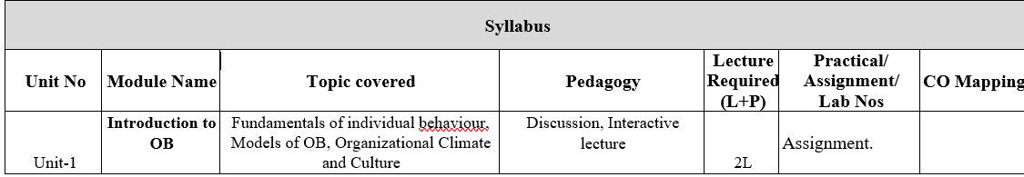
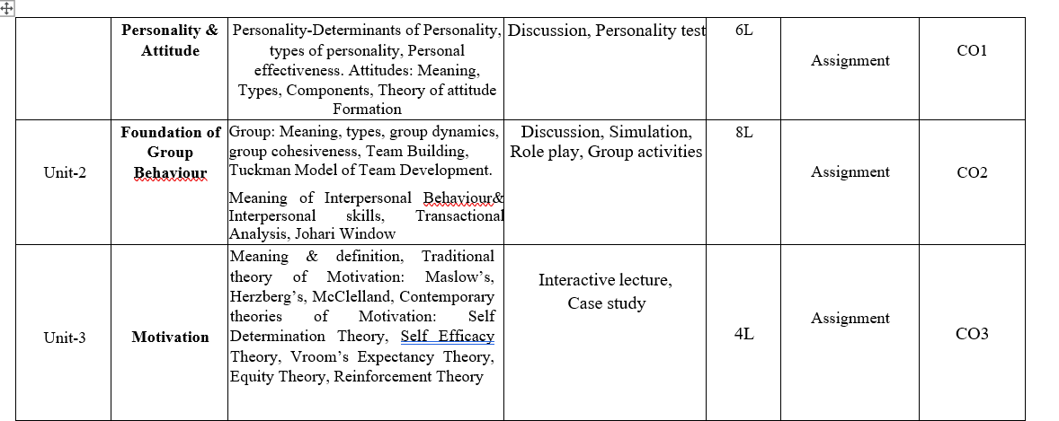
Syllabus

Slide 5
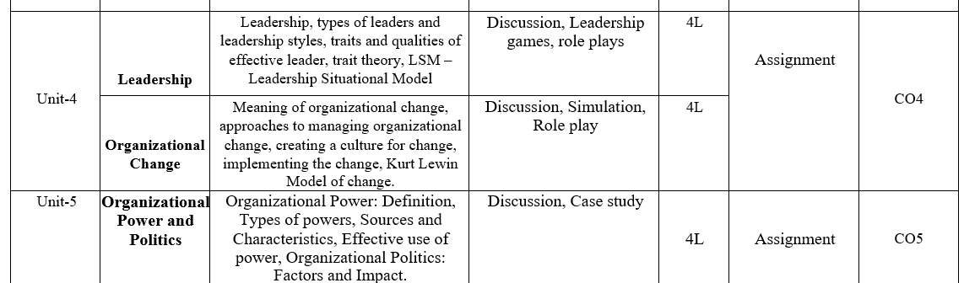
Syllabus

Slide 6
Branch Wise Applications
Being a core subject this subject will help the students gain understanding of the functions and responsibilities of managers. It shall provide students the tools and techniques to be used in the performance of the managerial job. And will also enable them to analyze and understand the complex human behaviour at organization.

Slide 7
Course Objectives
This course explores the theories and concepts of organizational behaviour and their application in the workplace. It covers individual behaviour, group dynamics, and organizational processes to enhance organizational effectiveness. The Organizational Behaviour course focuses on a better understanding of the key factors that determine human behavior in organizations. The course focuses on key factors for understanding the behavior of people in organizational contexts from a socio psychological point of view that play a basic role in people management and that are the basis of any leadership course in the rest of the program.

Slide 8
Course Outcomes

Slide 9
Program Outcomes

Slide 10
CO-PO Mapping

Slide 11
CO-PSO

Slide 12
CO-PEO

Slide 13
Result Analysis
NA

Slide 14
End Sem Question Paper Templete
NA

Slide 15
Prerequisite
Students should have a primary understanding of management thought.
Students should have preliminary knowledge of organizational Behaviour.

Slide 16
Brief subject introduction
Management comprises planning, organizing, staffing, leading or directing, and controlling an organization to accomplish a goal. It also includes resourcing that encompasses the deployment and manipulation of human resources, financial resources, technological resources, and natural resources. Organizational Behavior (OB) can be defined as the understanding, prediction and management of human behavior both individually or in a group that occur within an organization. Internal and external perspectives are the two theories of how organizational behavior can be viewed from an organization's point of view.
https://www.youtube.com/watch?v=5_btNIdvEfo
https://www.youtube.com/watch?v=Lx83q3mW0oo
https://www.youtube.com/watch?v=uXuj-Kj6_wE

Slide 17
Unit Content
Introduction to OB
Fundamentals of individual behavior, Models of OB
Organizational Climate and Culture
Personality & Attitude
Personality-Determinants of Personality, types of personality
Personal effectiveness. Attitudes: Meaning, Types, Components
Theory of attitude Formation

Slide 18
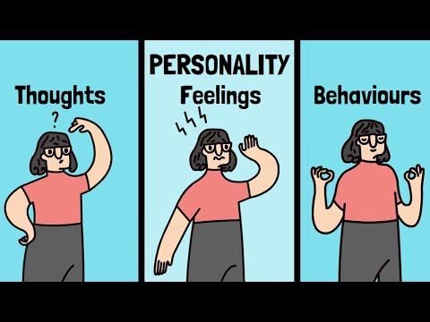
Personality
The word personality is derived from a Greek word “persona” which means “to speak through”. Personality is the combination of characteristics or qualities that forms a person’s unique identity.
Personality can be defined as those inner psychological characteristics that both determine and reflect how a person think and act in an environment.
.
Notes:
Clan Culture: emphasizes collaboration across teams and a horizontal structure.
Adhocracy Culture: allows individuals to share ideas and encourages the company to take risks.
Market Culture: focuses on financial success and how each employee contributes to revenue.
Hierarchy Culture: emphasizes career paths and provides clear managerial processes.

Slide 19
Personality
The dynamic organisation within the individual of those psychophysical systems that determine his unique adjustments to his environment
Gordon Allport
Personality is a broad, amorphous designation relating to fundamental approaches of persons to others and themselves. To most psychologists and students of behaviour, this term refers to the study of the characteristic traits of an individual, relationships between these traits and the way in which a person adjusts to other people and situations
J.B Kolasa
.

Slide 20
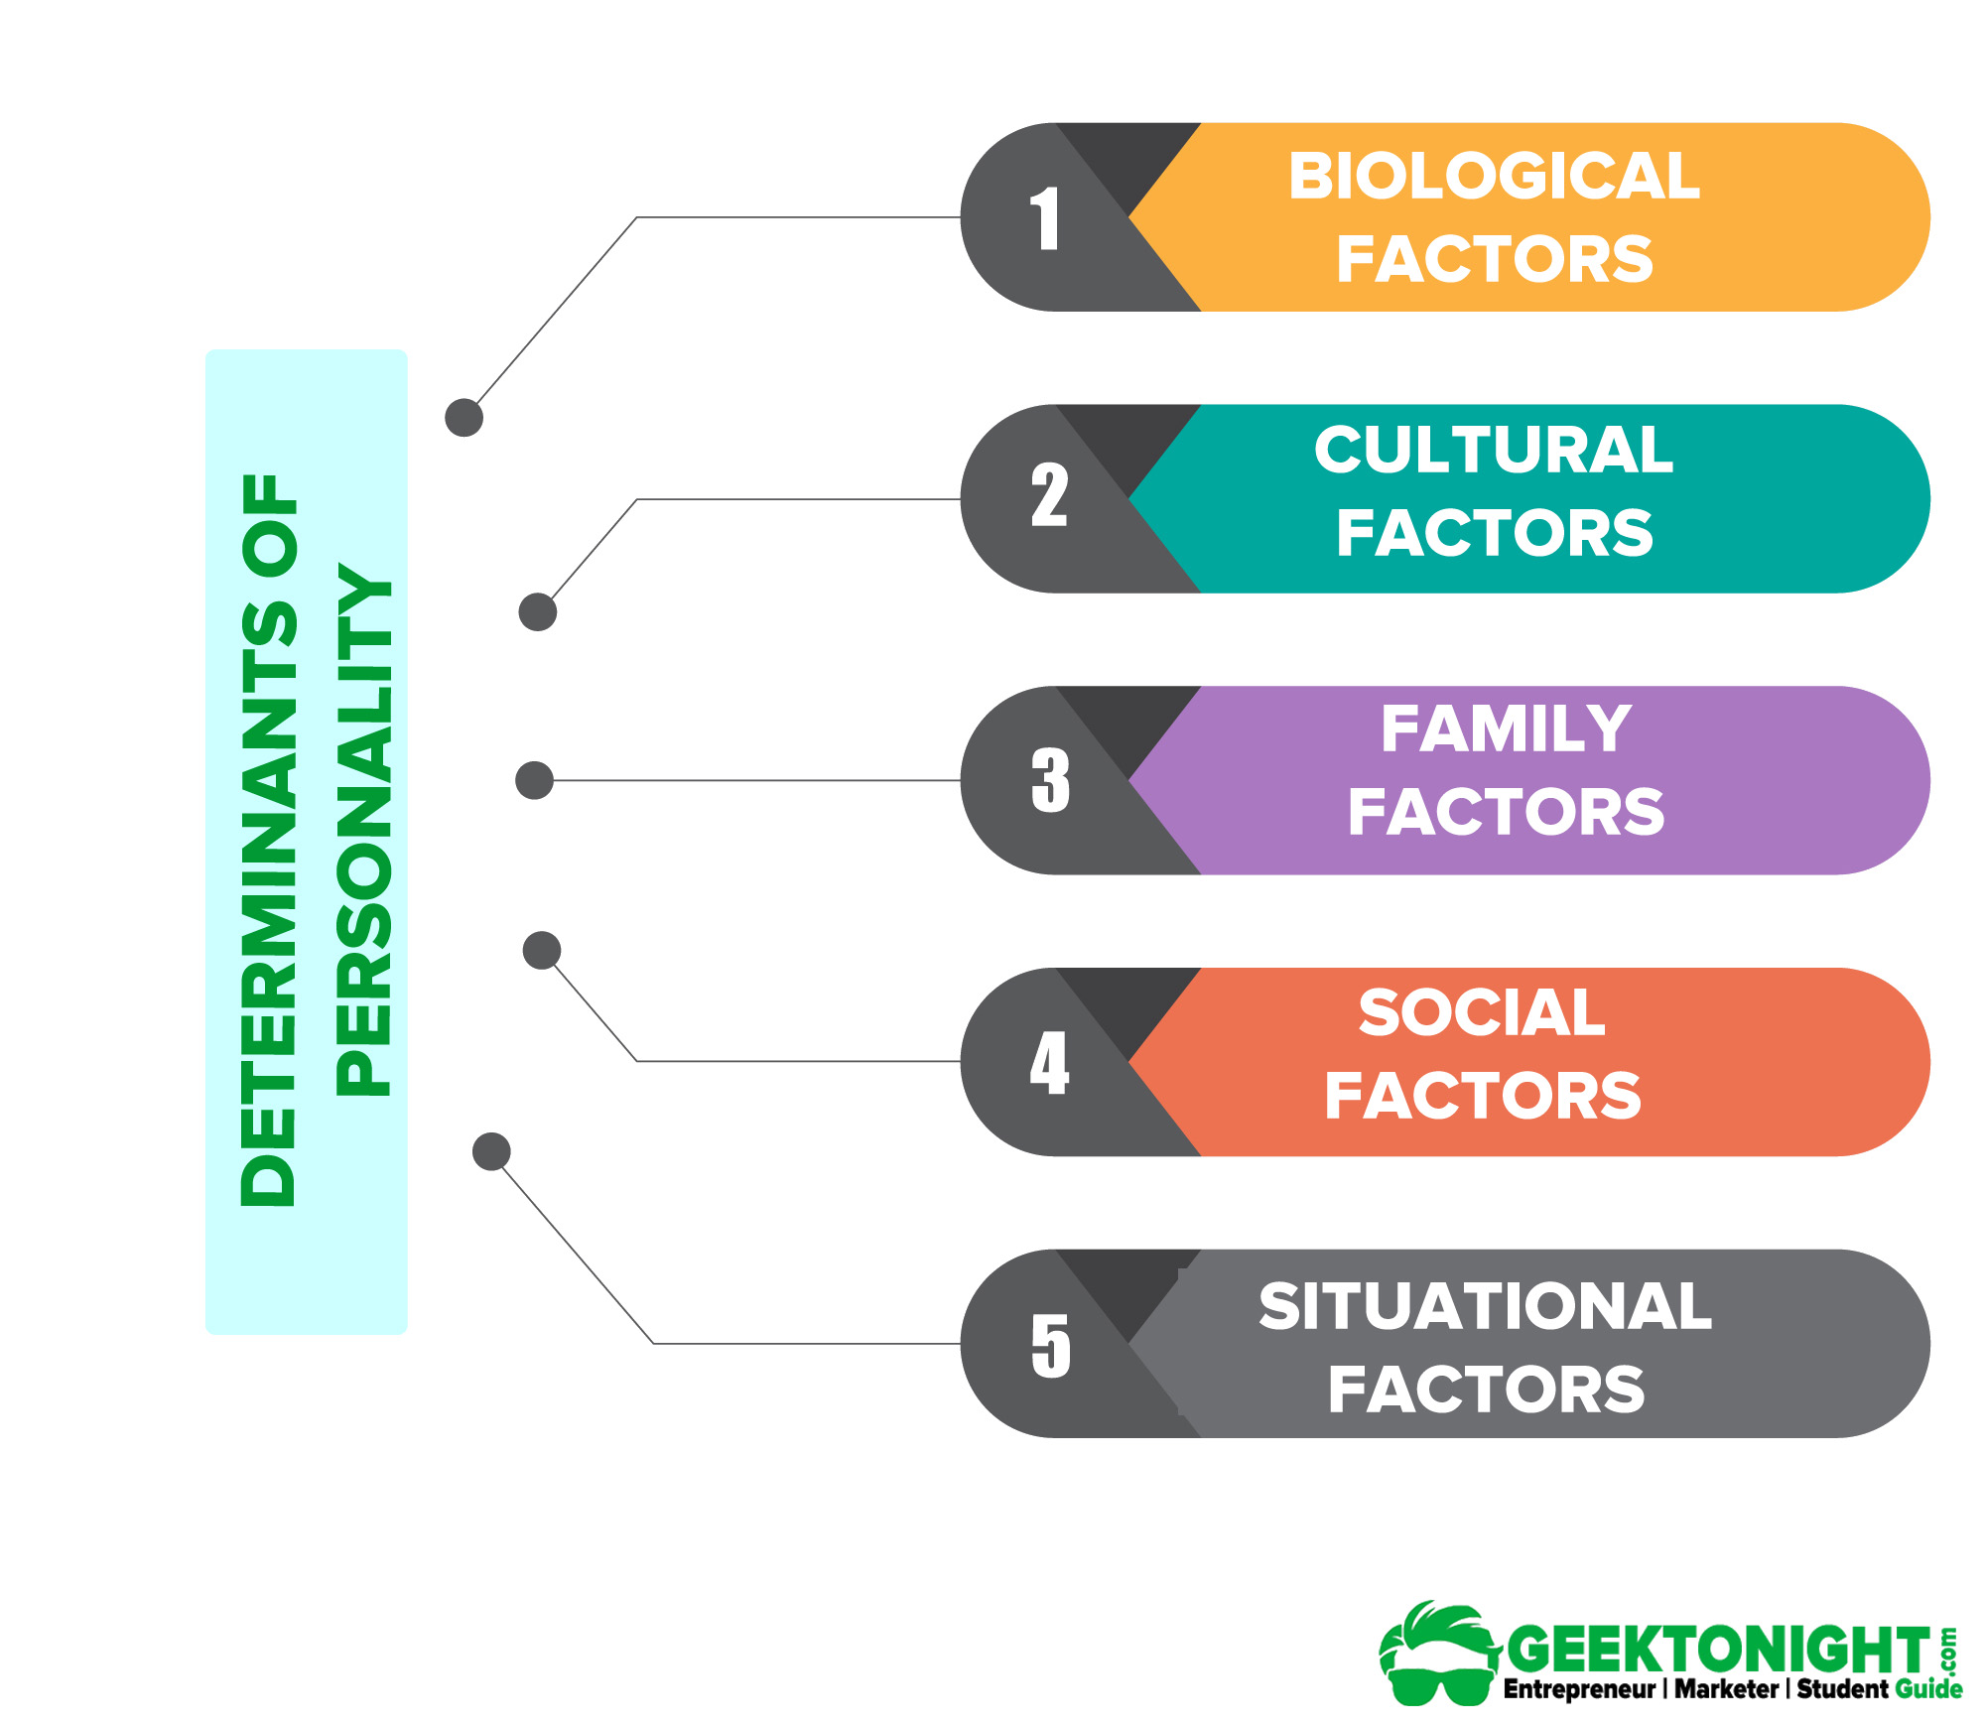
Determinants of Personality
.
Notes:
Biological Factors
The study of the biological contributions to personality may be studied under three heads:
Heredity
Heredity refers to those factors that were determined at conception. Physical stature, facial attractiveness, sex, temperament, muscle composition and reflexes, energy level, and biological rhythms are characteristics that are considered to be inherent from one’s parents.
Brain
The second biological approach is to concentrate on the role that the brain plays in personality. The psychologists are unable to prove empirically the contribution of the human brain in influencing personality.
Cultural Factors
Among the factors that influence personality formation is the culture in which we are raised, early conditioning, norms prevailing within the family, friends and social groups and other miscellaneous experiences that impact us.
The culture largely determines attitudes towards independence, aggression, competition, cooperation and a host of other human responses
Family Factors
Whereas the culture generally prescribes and limits what a person can be taught, it is the family, and later the social group, which selects, interprets and dispenses the culture. Thus, the family probably has the most significant impact on early personality development.
A substantial amount of empirical evidence indicates that the overall home environment created by the parents, in addition to their direct influence, is critical to personality development.
Social Factors
There is increasing recognition given to the role of other relevant persons, groups and especially organisations, which greatly influence an individual’s personality. This is commonly called the socialization process.
Situational Factors
Human personality is also influenced by situational factors. The effect of the environment is quite strong. Knowledge, skill and language are obviously acquired and represent important modifications of behavior.

Slide 21
Types of Personality
Extrovert Personality
Agreeable Personality
Conscientious Personality
Cautious Personality
Self-Conscious Personality
Adventurous Personality
Notes:
Extrovert Personality
The extrovert is a friendly person who is quick to establish relationships with others. Extroverts are gregarious and display a high level of social engagement. They enjoy being with people and like to be in the company of large groups. Extroverts are active and tend to get involved in many activities. At the opposite end of the spectrum, people with low levels of extroversion feel a greater desire for privacy, avoid large group situations and generally live a more leisurely life.
Agreeable Personality
The agreeable person can cooperate well with other people by putting aside personal needs while getting along with peers. These people trust others and rely on their integrity, character and abilities. Often the agreeable personality feels the need to help other people, and can derive fulfillment by offering support.
Conscientious Personality
Conscientious people exude confidence and feel capable of accomplishing goals. They may be overachievers who want to be viewed as successful.
Cautious Personality
Cautious people will look at problems from every angle before acting or making a decision, while those who are not cautious often act or speak before they think things through.
Self-Conscious Personality
Self-conscious people are highly sensitive to what others think and say about them. They dislike criticism and are sensitive to rejection, while those who are not all that self-conscious are not bothered by being judged by other people.
Adventurous Personality
People with an adventurous personality seek out new experiences and dislike routine. They may be unafraid to challenge authority and conventions, while those who are less adventurous may have traditional values and prefer security over adventurousness. Those with an adventurous personality enjoy having power and may be more amenable to taking risks.

Slide 22

Attitude
An attitude describes persons’ enduring favorable or unfavorable cognitive evaluations, feelings, and action tendencies toward some object or idea.
Attitudes are evaluation statements either favorable or unfavourable or unfavourable concerning objects, people or events. They reflect how one feels about something.
-Robbins
Notes:
In simple words, an “attitude” is an individual’s way of looking or an individual’s point of view at something.
To be more specific, an “attitude” may be defined as the mental state of an individual, which prepares him to react or make him behave in a particular pre-determined way. It is actually an acquired feeling.

Slide 23
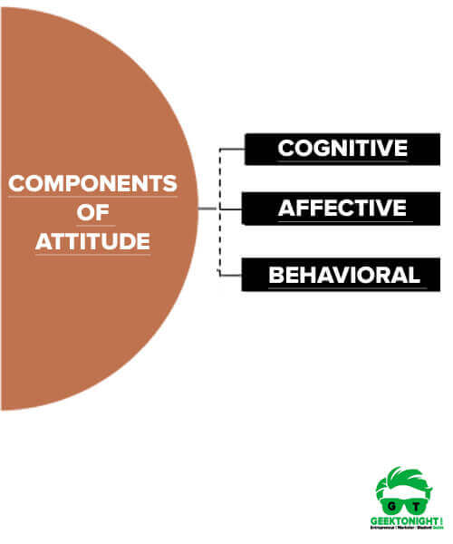
Components of Attitude

Slide 24
Cognitive component
Beliefs are the cognitive components of consumer attitude. The cognitive component of attitude is associated with the value statement. It consists of values, beliefs, ideas, and other information in which a person may have faith.
The cognitive component involves a person’s belief/knowledge about an attitude object.
For example: “I believe spiders are dangerous.”

Slide 25
Affective component
Affective is the emotive component of consumer attitude. Affective component of attitude is associated with individual feelings about another person, which may be positive, neutral or negative.
Affective component: this involves a person’s feelings/emotions about the attitude object.
For example: “I am scared of spiders.”

Slide 26
Behavioral component
Intention is the behavioral component of consumer attitude. Behavioral component of attitude is associated with the impact of various condition or situations that lead to person behavior based on cognitive and affective components.
Behavioral component: the way the attitude we have influenced how we act or behave.
For example: “I will avoid spiders and scream if I see one.”

Slide 27

Types of Attitude

Slide 28
Types of Attitude
Job satisfaction- is the level of contentment a person feels regarding his or her job. This feeling is mainly based on an individual’s perception of satisfaction.
Job involvement-
Job involvement refers to the degree to which a person identifies himself (psychologically) with his job, actively participates, and considers his perceived performance level important to self-worth.
Organizational commitment-
Organizational commitment refers to the degree to which an employee identifies himself with the organizational goals and wishes to maintain membership in the organization.
Notes:
Job Satisfaction-A person with a high level of job satisfaction holds positive attitudes about the job, while a person who is dissatisfied with his or her job holds a negative attitude about the job.A person having a negative attitude shows a personality disposition that is inclined to experience nervousness, tension, upset, distress, etc. whereas those with a positive attitude will feel happy themselves, others and their work. ▸ iedunote.com/types-of-attitudes
Job involvement
Job involvement refers to the degree to which a person identifies himself (psychologically) with his job, actively participates and considers his perceived performance level important to self-worth. (Robbins)
Higher job satisfaction leads to low absenteeism & employee turnover and indicates that the individual cares for his job.
Organizational commitment
Organizational commitment refers to a degree to which an employee identifies himself with the organizational goals and wishes to maintain membership in the organization.
Resigning from the job or absenting versus job satisfaction is a predictor of organizational commitment. Organizational commitment depends upon the degree of autonomy & freedom job and job enrichment factor.

Slide 29
Daily Quiz
The combination of characteristics or qualities that form an individual’s distinctive character” is the definition of ____
a) Personality
b) Motivation
c) Attitude
d) Behaviour
The family condition and impact of the parents is the main base for the personality of a person. Later it might change by ________
a) thinking
b) external influences
c) own ability
d) learning experiences

Slide 30
Daily Quiz
Every individual is ________ by their personality.
a) Intellectual
b) Specific
c) Unique
d) Systematic
Outgoing, talkative, social are part of __________ Personality Trait as per big 5 personality trait
a) Friendly
b) Openness to experience
c) Introversion
d) Extroversion

Slide 31
Johari Window
Johari Window is a technique for improving self-awareness within an individual. It helps in understanding your relationship with yourself and others. The Johari Window model can be useful if you want to improve your communication skills.
It was developed by American psychologists Joseph Luft and Harry Ingham in 1955.

Slide 32
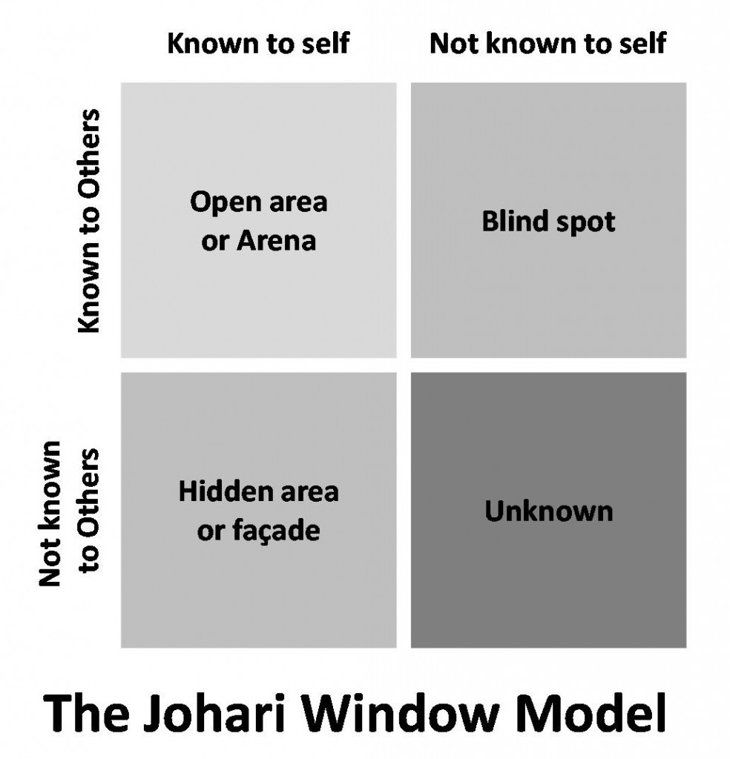
Johari Window
The Johari window model is based upon two things – to acquire the trust of others by revealing your information to them and by learning about yourself through feedback from others.

Slide 33
Open/self-area or arena
Here the information about the person's attitudes, behavior, emotions, feelings, skills, and views will be known by the person and others.
The Open Area represents the things that you know about yourself and that others know about you. This includes your behavior, knowledge, skills, attitudes, and "public" history.

Slide 34
Blind Area
The Blind Area represents things about yourself that you aren't aware of, but that others know about you. For example, you might not realize you're a great listener until someone points it out to you. It can also reveal deeper issues, such as feelings of incompetence or anger you haven't faced up to, but that others sense in you.

Slide 35
Hidden Area
The Hidden Area represents things that you know about yourself, but that you keep hidden from other people.
You don't need to share all of your private thoughts and feelings with work colleagues. Naturally, you wouldn't want to reveal anything that would make you feel embarrassed or vulnerable. Withholding information is perfectly reasonable if it has no bearing on your work..

Slide 36
Unknown Area
The Unknown area represents things that are unknown to you and by others.
A large Unknown Area may just be a sign of youth or inexperience, but it can also mean that you need to work hard on discovering and releasing new information about yourself.

Slide 37
Daily Quiz
Which one is NOT a pane of Johari Window model?
blind spot
unknown area
hidden area
changing area
The unknown area of Johari Window is ___________.
the same as the blind area.
made up of private feelings & needs you don't want to share
an area you need to enlarge in order to build friendships.
an area that you don't know completely & never disappears.

Slide 38
Daily Quiz
Transactional analysis was the brainchild of:
Thomas Harris
Eric berne
Muriel James
Stephen robbins
Transactional Analysis (TA) is related to.
(A) Learning.
(B) Attitudes.
(C) Perception.
(D) Personality

Slide 39
Transactional Analysis
.
Transactional analysis is a form of modern psychology that examines a person's relationships and interactions. It is a psychoanalytic theory and method of therapy that analyzes social interactions to determine the ego state of the communicator.

Slide 40
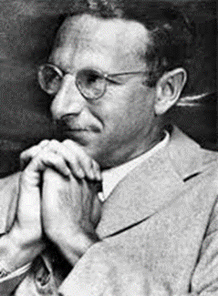
Transactional Analysis
Developed by Canadian born US psychiatrist Eric Berne during the late 1950s.
Transactional Analysis (TA) is is a psychoanalytic theory and method of therapy, developed by Eric Berne during the 1950s. Transactions refer to the communication exchanges between people.
A model for explaining why and how:
People think as they do
People act like they do
People interact/communicate with others
.

Slide 41
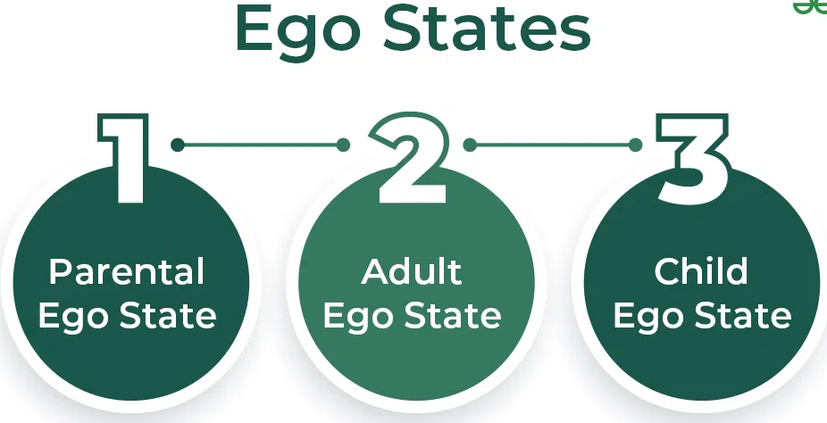
3 Ego States
.
.
Notes:
According to TA, we have three sides or 'ego-states' to our personality – the Parent, Adult and Child ego states.
An ego state is a way of us experiencing the world. It is an entire system of thoughts, feelings, and behaviours from which we interact with one another

Slide 42
3 Ego States
.
Parent ego state: Represents learned behaviors, attitudes, and values from authority figures.
Adult ego state: Represents rational thinking and decision-making.
Child ego state: Represents emotions, feelings, and behaviors learned during childhood.

Slide 43
Types of transaction
.
Complementary transactions- are when two people's ego states are sympathetic or complementary to one another.
Example: A supervisor communicates in the parent-to-child ego when he reprimands an employee for being late. If the employee responds by apologizing and saying it won't happen again, the employee is in the child-to-parent ego state and the result is a complementary transaction.

Slide 44
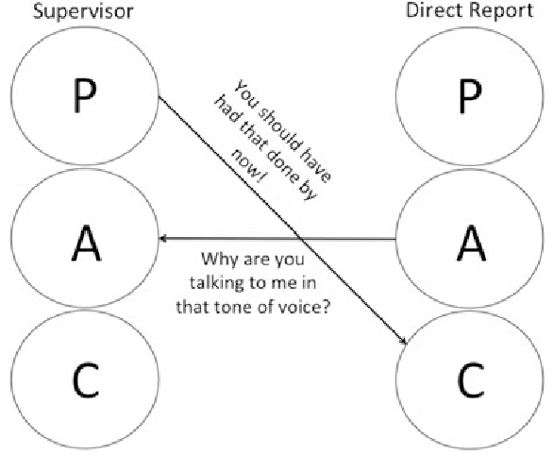
Crossed transactions
.
Crossed transactions- Crossed transactions happen when Person 1 says something from one ego state, and receives a different response than he/she is expecting.

Slide 45
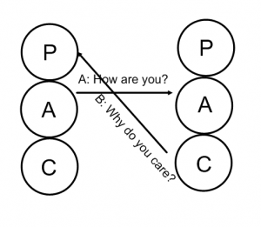
Ulterior Transactions
.
Crossed transactions- In ulterior transactions two messages are conveyed at the same time — a social message on top and the psychological message at the bottom.

Slide 46

Motivation

Slide 47
Motivation
Motivation is a psychological process through which a person acts or behaves towards a particular task or activity from start to completion. Motivation drives or pushes a person to behave in a particular way. When the motivation is positive, a person is happy, energetic, enthusiastic & self-driven to perform the work. When it is negative motivation, a person is demoralized, sad, lethargic & pessimistic leading to a drop in productivity and performance.

Slide 48
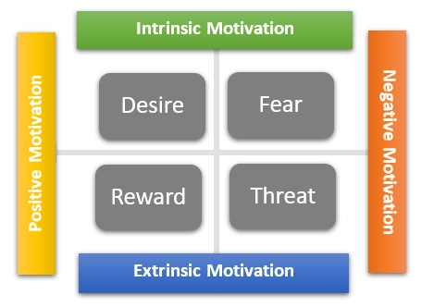
Types of Motivation

Slide 49
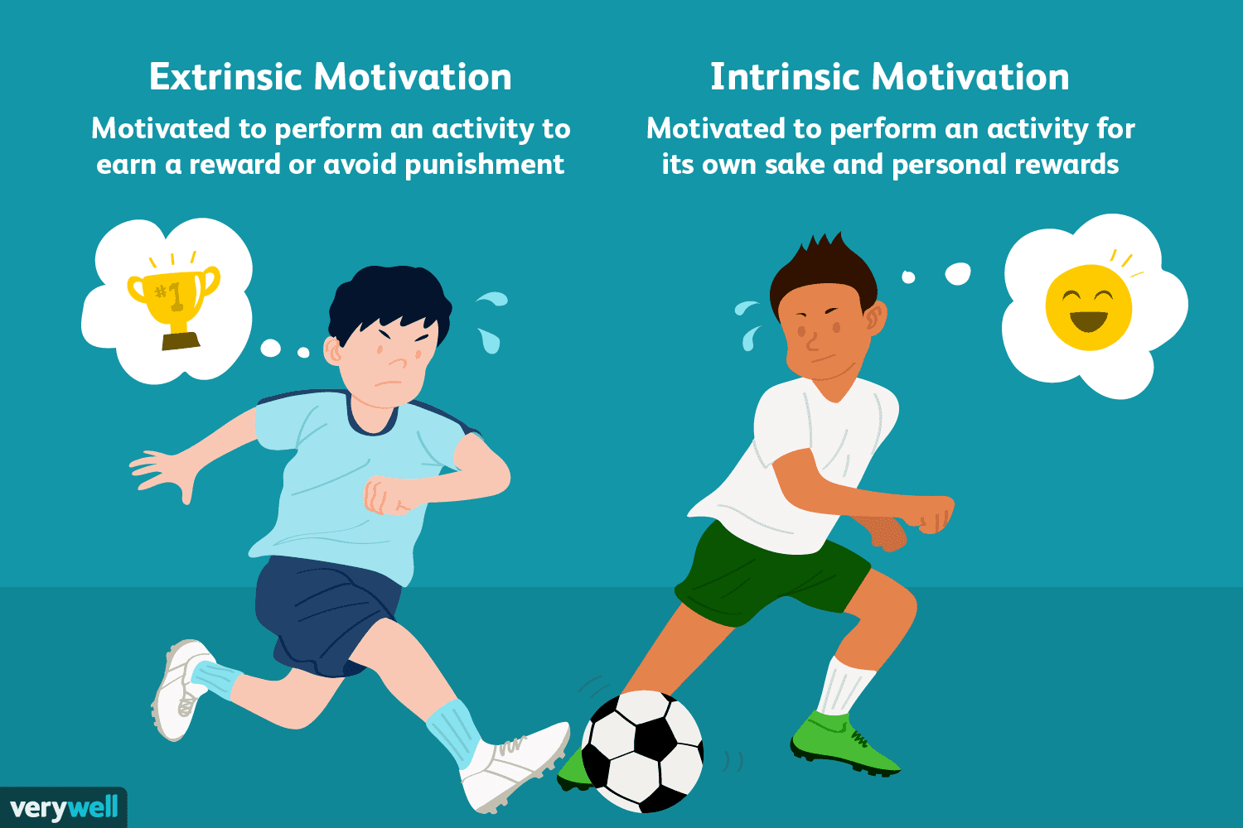
Extrinsic & Intrinsic Motivation
Notes:
1. Intrinsic Motivation
This type comes from within a person to do a task or achieve a particular goal. It is a feeling of being self-driven and achieving objectives for oneself. Intrinsic motivation is driven by motives like social acceptance, eating food, desires to achieve goals, biological needs etc.
2. Extrinsic Motivation
This type drives an individual due to external forces or parameters. Some other person or organization motivates the individual to work hard to achieve certain goals or tasks. Extrinsic motivation is driven by motives like financial bonus, rewards, appreciation, promotion, punishment, demotion etc.

Slide 50
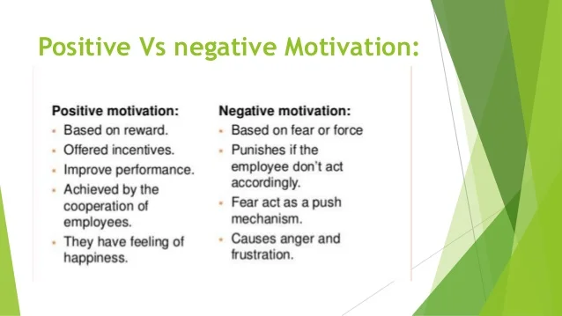
Positive and Negative Motivation
Notes:
Positive Motivation: It is the reward based motivation which tires to create willingness to perform better. It improves performance, increase mutual cooperation and develops trust between employees and management. Positive motivation may take the form of monetary, nonmonetary or both. Examples Monetary Incentive:- pay increment, cash reward, bonus payment, leave with pay, profit sharing scheme, retirement benefit and Non monetary Incentive:- promotion, participation in decision-making ,recognition, autonomy or freedom to work, challenging work.
b. Negative Motivation: Negative motivation means the act of forcing employees to work by means of threat and punishment. It involves disciplinary actions. Examples: Monetary: - fines, penalties, pay cut, Non-monetary:- demotion, threat of dismissal from job, transfer to remote areas, and group rejection. Since, this is not good practice. However, sometimes manager may be compelled to use this technique with a view to prevent them from undesirable behavior.

Slide 51
Nature of employee motivation
Motivation is an internal feeling
Motivation produces goal-directed behavior
Motivation can be either negative or positive
Motivation is a complex process
Continuous process
Notes:
Motivation is an internal feeling: It is a psychological concept and it cannot be forced on the employees. It is an internal feeling, generated within an individual, which compels him to behave in a particular manner. Feelings like needs, desires, urges, etc., influence human behaviour to act in a particular manner.
Motivation produces goal-directed behaviour: Employees’ behaviour is influenced by motivation in such a way that they can achieve their goals. Motivation helps to achieve both organisational as well as individual goals. For example, if a person wants to get a promotion, then he will work harder to achieve the goals effectively and efficiently.
Motivation can be either negative or positive: Motivation can be either positive in form of rewards, like additional pay, incentives, promotion, recognition, etc., or negative in the form of force, like punishment, threat of demotion, etc. Positive motivation provides incentives to an individual to achieve the goal, whereas negative motivation creates fear in the mind of individuals in order to influence their behaviour to act in a desired manner.
Motivation is a complex process: Humans are heterogeneous in their expectations, perceptions and reactions. A particular type of motivation may not have the same effect on all individuals as it is difficult to predict their behaviours. Therefore, motivation is a complex task.
Continuous process: As human needs are unlimited, completion of one need gives rise to another, and it goes on. Therefore, motivation is a continuous process, and it does not end with the satisfaction of a particular need.

Slide 52
Objectives of Motivation
Motivation helps to improve the performance level.
Motivation helps in changing a negative attitude to a positive attitude.
Motivation helps to reduce employee turnover.
Motivation helps to reduce absenteeism.
Motivation helps to introduce changes smoothly.

Slide 53
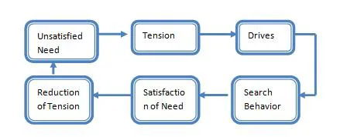
Process of motivation
Notes:
Unsatisfied need. Motivation process begins when there is an unsatisfied need in a human being.
Tension. The presence of unsatisfied need gives him tension.
Drive. This tension creates an urge of drive in the human being an he starts looking for various alternatives to satisfy the drive.
Search Behavior. After searching for alternatives the human being starts behaving according to chosen option.
Satisfied need. After behaving in a particular manner for a long time then he evaluates that whether the need is satisfied or not.
Reduction of tension. After fulfilling the need the human being gets satisfied and his tension gets reduced.
For example, if an employee develops a need to earn more, this need will make him restless and he will start thinking how to satisfy his need. To satisfy his need he may think of working hard in organization and get promotion so he will start working hard. After sometime he will get incentives or increments or promotion which will satisfy his need.

Slide 54
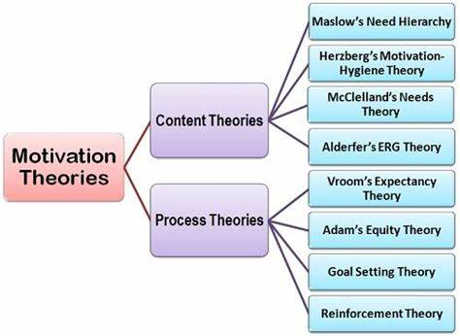
Theories of motivation

Slide 55
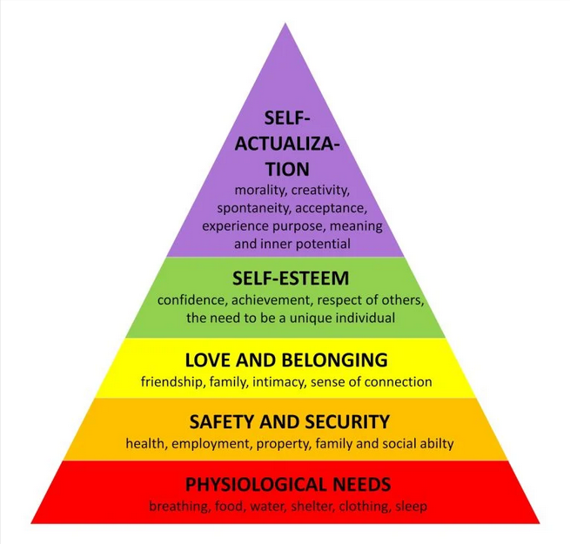
Maslow’s Theory of Motivation
Notes:
Physiological needs: Basic necessities like food, water, and shelter.
Safety needs: Security, stability, and protection.
Love and belonging: Social connections, relationships, and a sense of belonging.
Esteem: Recognition, respect, and self-worth.
Self-actualization: Fulfillment of one's potential and personal growth

Slide 56
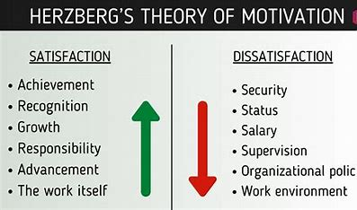
Herzberg’s Two Factor Theory
Herzberg and his associates conducted a research based on the interview of 200 engineers and accountants who worked for eleven different firms in the Pittsburgh area.
Two Factors-
1- Hygiene Factor
2. Motivation Factor

Slide 57
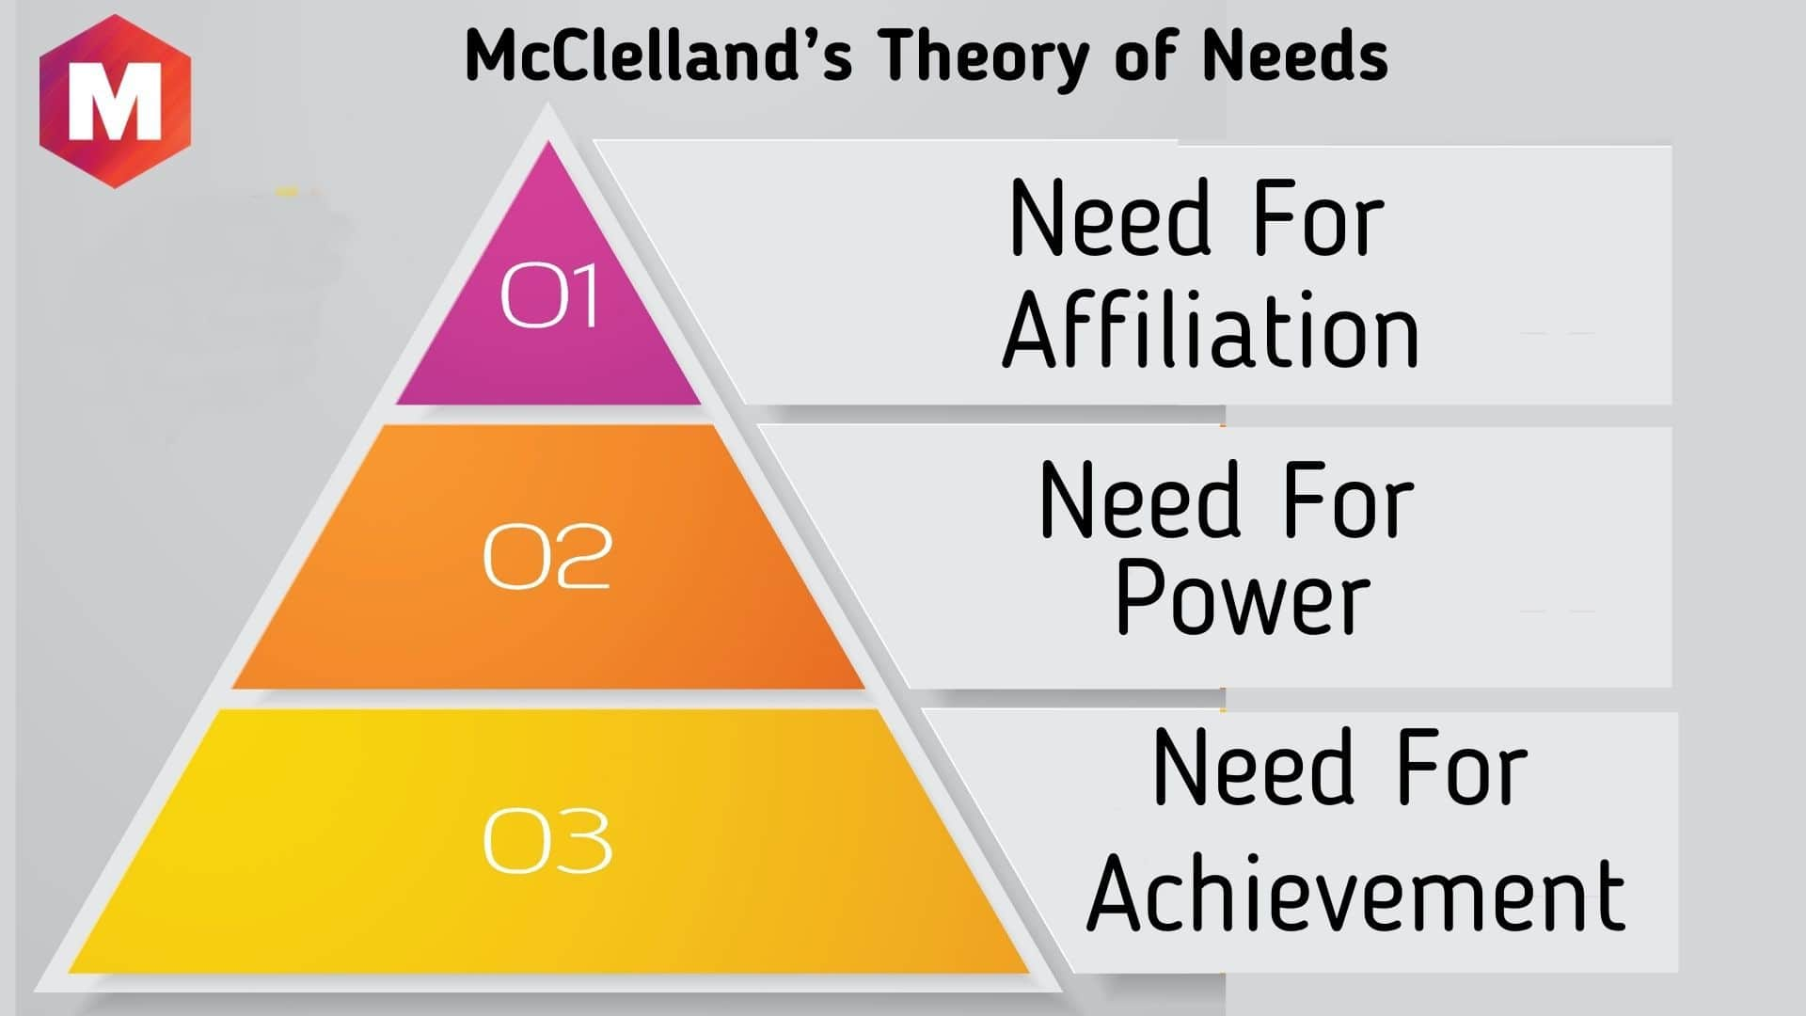
McClelland’s theory of needs
Notes:
This theory was developed in the 1960s by David McClelland..
Need For Achievement
The need for achievement as the name itself suggests is the urge to achieve something in what you do. If you are a lawyer it is the need to win cases and be recognized, if you are a painter it is the need to paint a famous painting.
Need For Power
The need for power is the desire within a person to hold control and authority over another person and influence and change their decision in accordance with his own needs or desires. The need to enhance their self-esteem and reputation drives these people and they desire their views and ideas to be accepted and implemented over the views and ideas over others.
Need For Affiliation
The need for affiliation is the urge of a person to have interpersonal and social relationships with others or a particular set of people. They seek to work in groups by creating friendly and lasting relationships and have the urge to be liked by others.

Slide 58
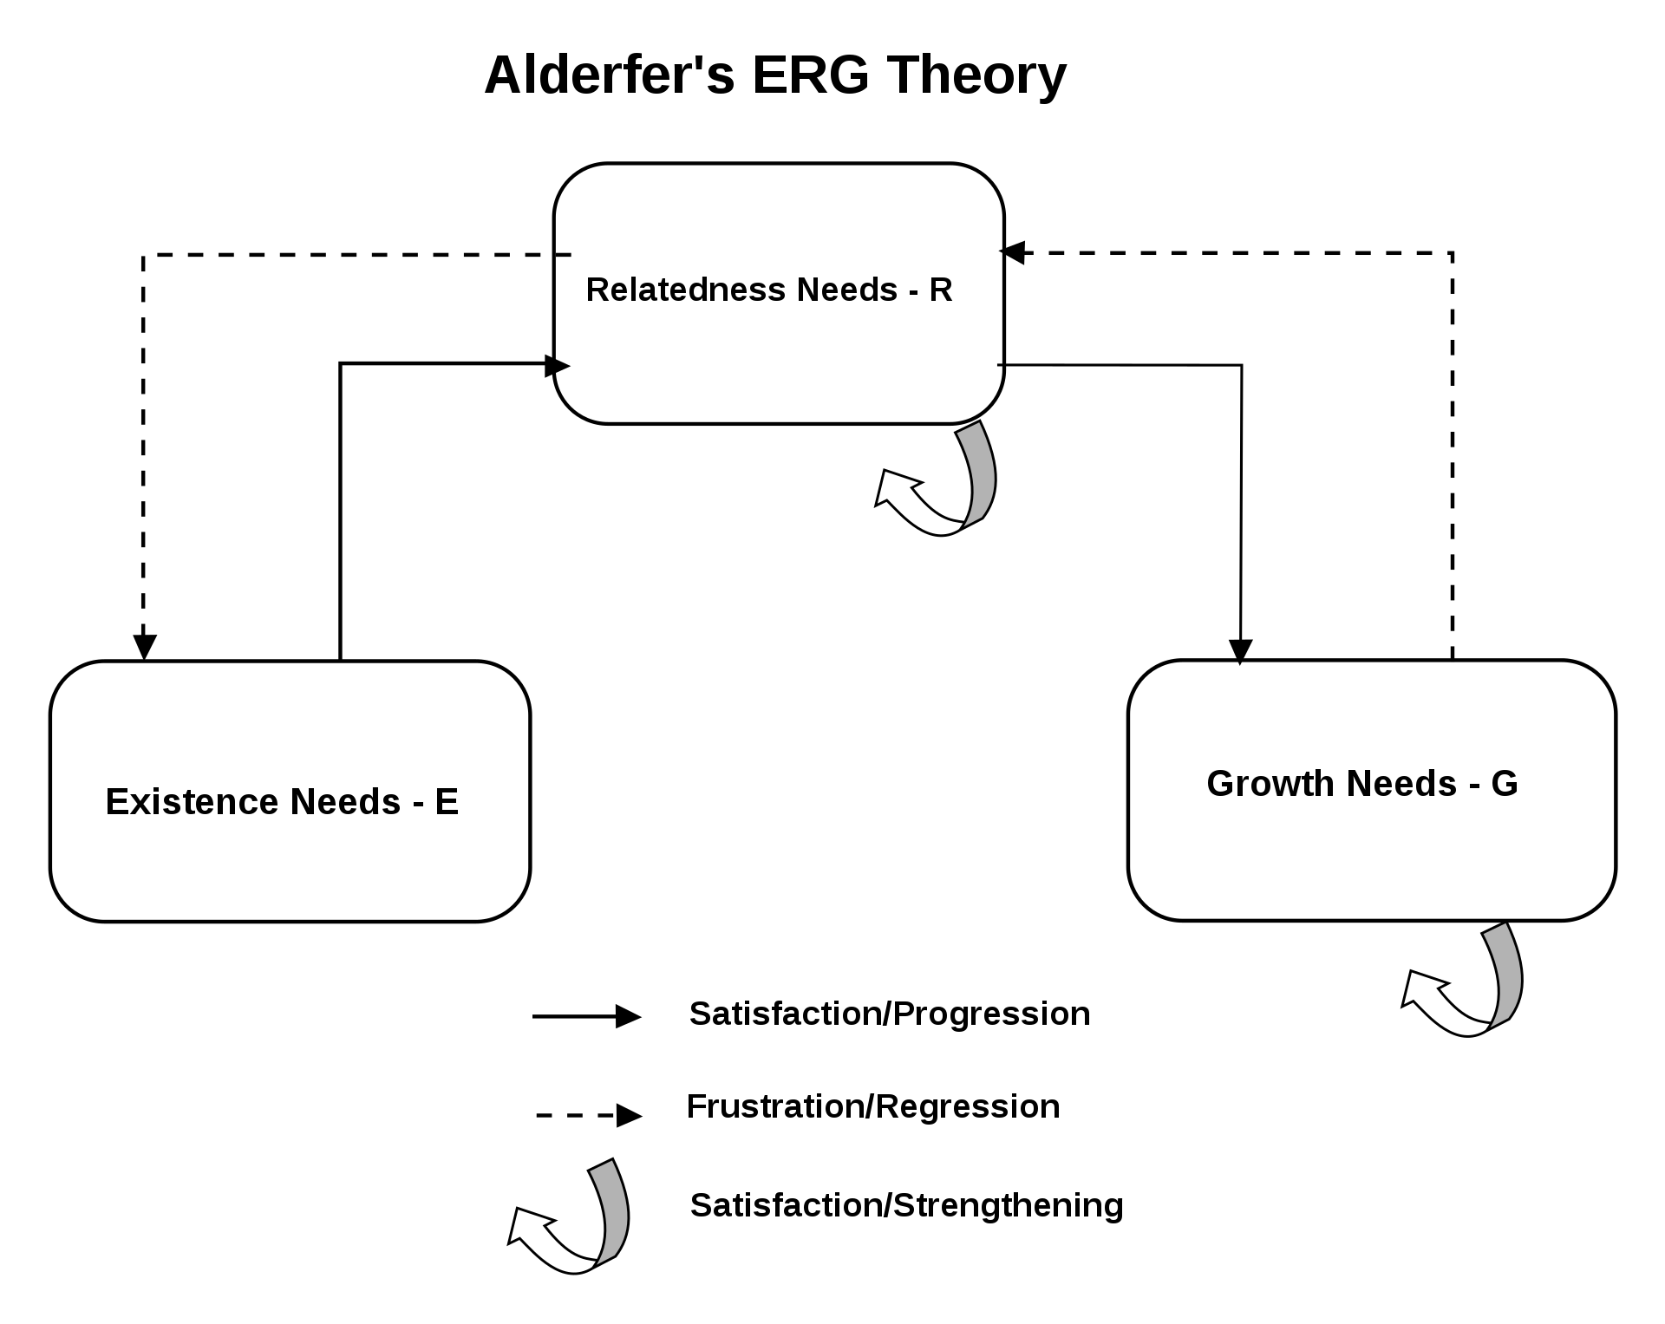
Alderfer’s ERG Theory

Slide 59

Vroom’s Expectancy Theory
room’s expectancy theory of motivation says that individuals are motivated to do something by three things. They are motivated when they value the reward associated with an action, trust that they’ll receive the reward if they do a good job, and believe they can achieve their objectives by working hard.
Motivation is a function of valence, instrumentality and expectancy.
Notes:
Valence: How much they value the potential rewards associated with the specific results or behaviors,
Expectancy: How much they believe that their additional effort will help them achieve the target results of behaviors, and
Instrumentality: How much they believe the rewards will actually appear should they achieve the desired outcomes or behaviors.

Slide 60
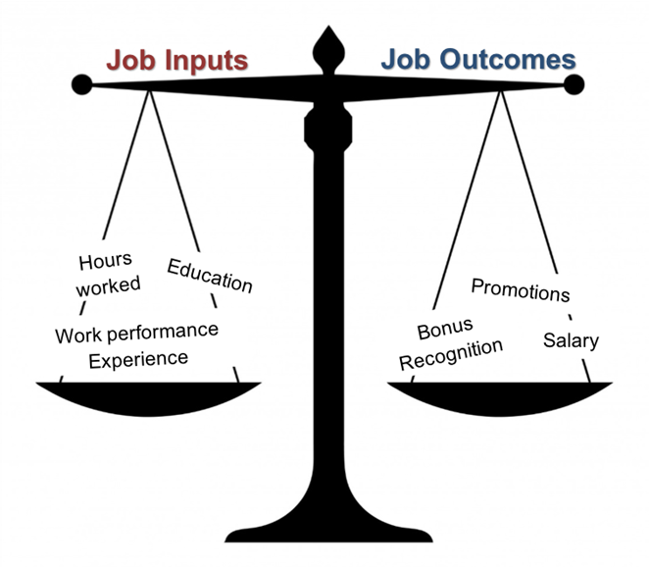
Adams’ equity theory
Adams’ equity theory is a process model of motivation. It says that the level of reward we receive, compared to our sense of our contribution, affects our motivation. The theory considers the concept of equality and fairness and the importance of comparison to others.

Slide 61
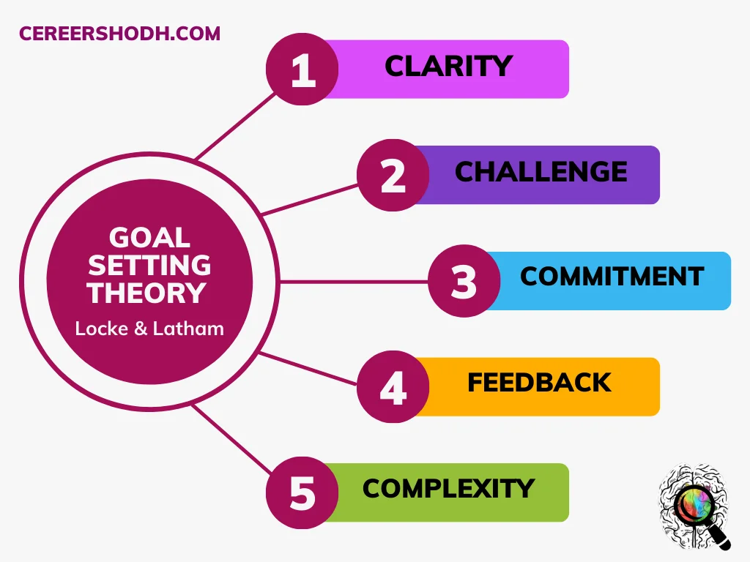
Goal-setting theory
Goal-setting theory is a concept that describes the strong link between goal setting and task motivation. It explains that creating specific, measurable, and difficult goals unlocks higher performance in individuals compared to easy goals that merely ask them to try their best.

Slide 62
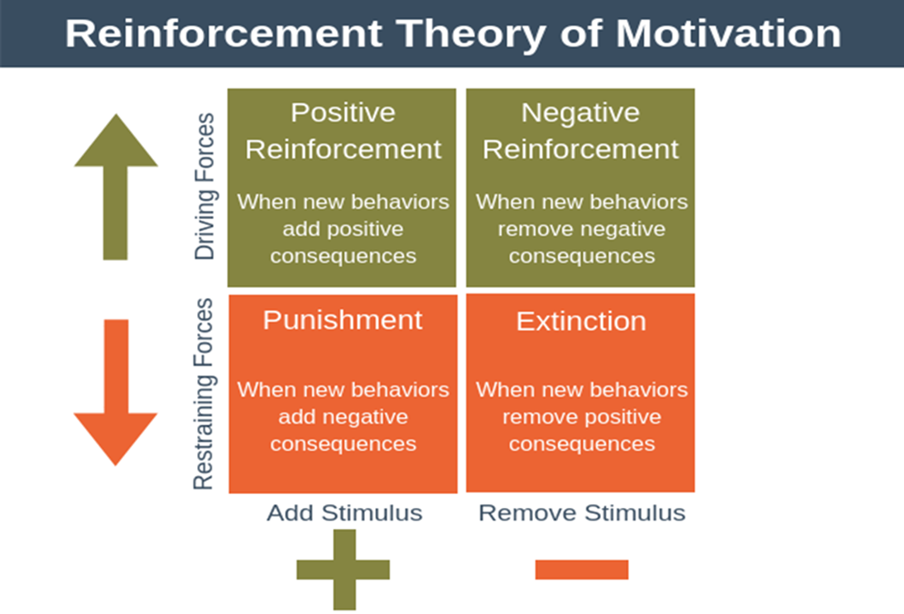
Reinforcement Theory

Slide 63
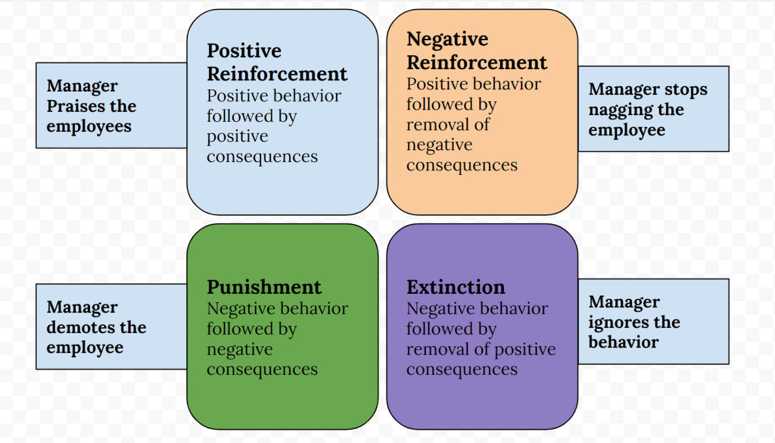
Reinforcement Theory

Slide 64
Daily Quiz
_____ theory argues that behaviour is a function of its consequences.
Equity
Reinforcement
Goal-setting
Expectancy
_____ focuses on core job attributes, critical psychological states, and expected outcomes.
a. The equity model
b. The expectancy model
c. The two-factor model
d. The job characteristics model

Slide 65
Daily Quiz
Which is NOT a dimension in Maslow's Hierarchy of Needs?
Ego
Physiological
Safety
Esteem
_____ theory argues that behaviour is a function of its consequences.
Equity
Reinforcement
Goal-setting
Expectancy
Who has given the ERG theory of motivation?
Clayton Alderfer
David McClelland
Victor Vroom
Frederick Herzberg
Douglas McGregor

Slide 66
Youtube Video Links
Youtube/other Video Links
https://www.youtube.com/watch?v=R3aonvQQOt8
https://www.youtube.com/watch?v=tCEuJxJH4qA
https://www.youtube.com/watch?v=E8s-IsB2p5c

Slide 67
Weekly Assignment
Discuss the different Ego states in Transactional Analysis.
Explain Johari window as a tool for interpersonal effectiveness.
Write a descriptive note on the process of Motivation.
State the determinants of Personality.
Explain the process of Attitude formation.

Slide 68
MCQ s
1. Major determinants of personality
Biological
Situation
Both (A) and (B)
None of the above
2. Mismatch between personality and organization may lead(s) to
Confusion and chaos
Loss of interest by members in organization
Low morale and job satisfaction
All of the above

Slide 69
MCQ s
3. __ in the year 1954 proposed the need Hierarchy theory of Motivation.
Abraham Harold Maslow
Herzberg
Adam’s Equity Theory
None
4. According to ___ work effort in an organization is directed towards behaviours that people believe will lead to desired outcomes.
Expectancy Theory
Self Determination Theory
Maslow Theory
None

Slide 70
MCQ s
5. Which of the following would be classified by Herzberg as a hygiene factor?
Promotion
Personal growth
Achievement
Company policy
Responsibility
6. Which among the following is correct expansion of ‘ERG’ in ERG theory of motivation?
E – Existence, R – Religion, G – Growth
E – Experience, R – Related, G – Growth
E – Existence, R – Related, G – Growth
E – Existence, R – Requirement, G – Growth
E – Effectiveness, R – Related, G – Growth

Slide 71
MCQ s
7. _____ is the set of forces that energize, direct, and sustain behavior.
a. Motivation
b. Expectancy
c. Empowerment
d. Socialization
8. Maslow’s hierarchy of needs includes all of the following categories EXCEPT _____.
a. safety
b. growth
c. physiological
d. self actualization

Slide 72
Expected Questions for University Exam
Define Motivation. Explain traditional theories of motivation.
Discuss how many factors are there in Herzberg theory of motivation.
Explain each level in Maslow’s need theory.
State and explain any one contemporary theory of Motivation.
Enlist the factors in Expectancy theory.
Discuss Equity theory.
Explain the different types of transactions and ego states in transactional analysis.
Explain the different types of Attitudes.
Explain the concept of Attitude and its formation in detail.
Define Personality.
State the determinants of Personality.
Differentiate between Type A and Type B personality.
Discuss the concept of Johari Window.

Slide 73
Recap of the Unit
This topic tells us about the Two words attitude and personality are used interchangeably but there is a key difference between these two words. Personality is basically a combination of quality or the characteristic of any individual. On other hands, attitude refers to a way of thinking, belief or an emotion of an individual.
Motivation is essentially the underlying drive of individuals to accomplish tasks and goals. Many factors can influence employee motivation, including organizational structure, integrity of company operations, and company culture.

Slide 74
References
1.Koontz Harold, Weihrich Heinz& Mark V. Cannice – Essentials of management (Tata McGraw Hill, 11thEdition,2020)
2. Robbins Stephen P& Judge Timothy A. ―Organizational Behaviour (Pearson)
3. Robbins &Coulter :Management (Pearson, 14th Edition, 2019)
4. Pareek Udai :Understanding Organizational Behaviour, (Oxford University Press, 4th Edition, 2016)
5.Luthans Fred : Organizational Behaviour, (McGraw Hill International Edition, 12th Edition,2013)
6. Prasad L. M. : Principles and Practices of Management, (SultanChand& Sons, 9th edition,2016)

